Slide 1

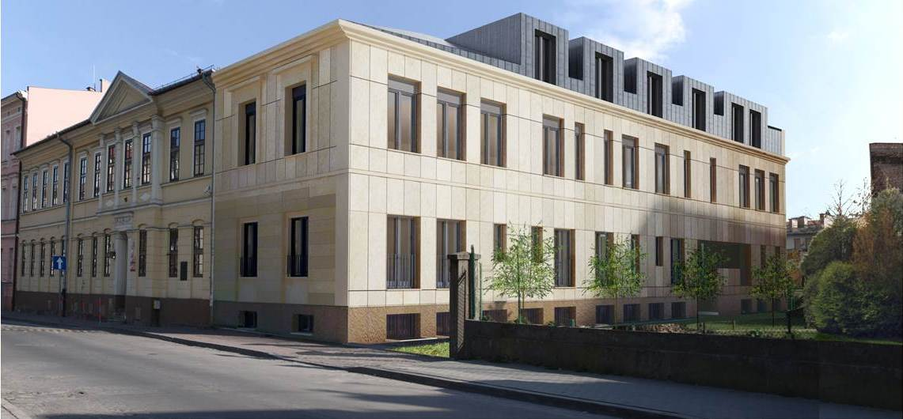
BRONISŁAW RUTKOWSKI PRIMARY
AND SECONDARY MUSIC SCHOOL in CRACOW, POLAND

Slide 2
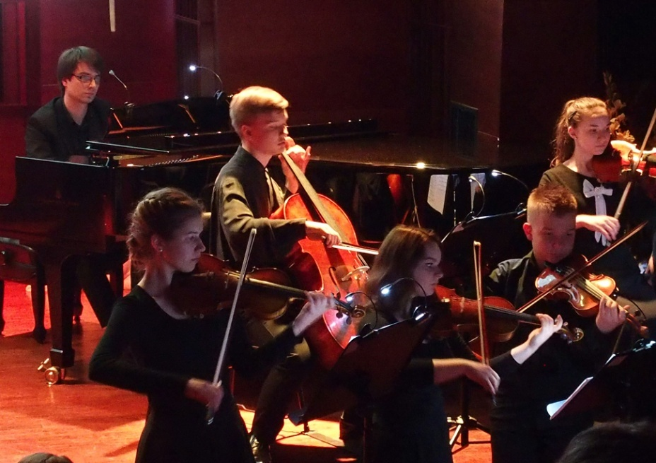
Bronisław Rutkowski Primary and Secondary Music School in Cracow
Mission of the School
The aim of the school is to educate children and young people to be professional musicians.
Currently, there are 552 students learning at our school
in all the departments and specialities
There are 125 music teachers employed.

Slide 3
Bronisław Rutkowski Primary and Secondary Music School in Cracow
School's learning system
Our school's learning system is based on Individual courses in music performance on the solo instrument or vocal courses,
group courses in general music education, group performance, choir, orchestra and big band.
Our school provides only music courses.
We do not provide any courses in regular school subjects.
The school offers the possibility to learn playing almost all the most popular existing instruments

Slide 4
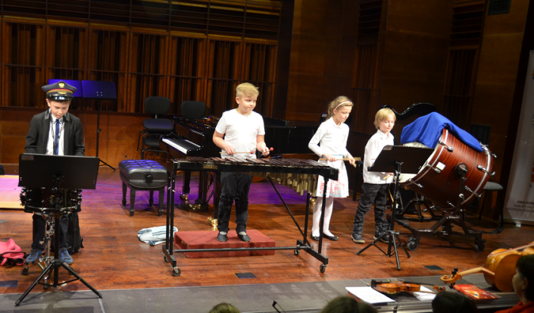
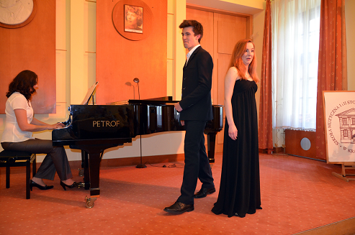
Bronisław Rutkowski Primary and Secondary Music School in Cracow
Two Levels of Education
School of Music of the 1st Level
6 year cycle – admissions at the age from 5 to 8
4 year cycle – admissions at the age from 9 to 16
Students can learn to play all the instruments available at the school
School of Music of the 2nd Level
Admissions at the age of up to 23
Instrumental Department – continuation of musical education for those who have mastered playing the instruments on the primary level
Vocal Department – for all the candidates who are at least 16

Slide 5
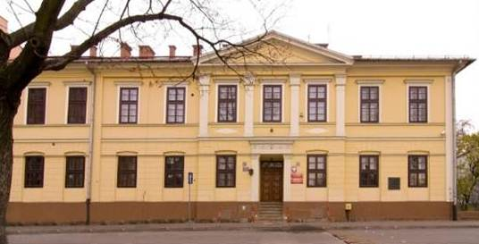
Bronisław Rutkowski Primary and Secondary Music School in Cracow
HISTORY: 1964 – the Primary School of Music
The National Music School of the 1st Level (a primary music school)
was established on 31st October 1964.
In 1968 the school obtained its own building – a valuable example of the late classical architectural style of the Austrian provenience
It was a historic building – during the World War II it was the seat of the Employment Office where Oskar Schindler would hire his Jewish workers to save them from a martyr’s death.

Slide 6
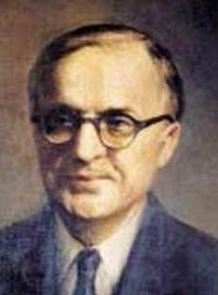
Bronisław Rutkowski Primary and Secondary Music School in Cracow
HISTORY: the School Patron
In 1974 the school was named after
Bronisław Rutkowski.
Bronisław Rutkowski was a famous Polish organist and pedagogue, rector of the National Higher School of Music (now Academy of Music)
in Cracow, and an eminent social activist, who had died 10 years earlier.

Slide 7
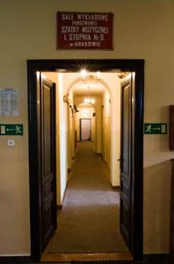
Bronisław Rutkowski Primary and Secondary Music School in Cracow
HISTORY: 1974 - 2002
In a short time, the school became an institution with a full range of musical education, and it was teaching almost all the instrumental specialities.
Chamber ensembles, a choir and an orchestra were brought to life too.
Since 2002
Marta Nowaczyk-Łapińska
has been the head director of the School
and Jerzy Kulawik has been her deputy

Slide 8
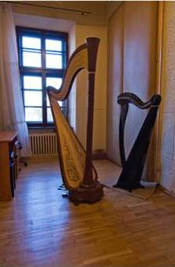
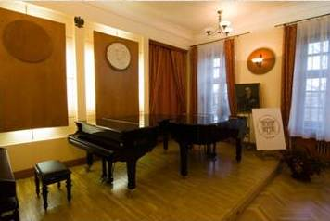
Bronisław Rutkowski Primary and Secondary Music School in Cracow
2004 – a general reconstruction
In 2003-2004 a general reconstruction of the front elevation as well as the school auditorium, class rooms and corridors was done.
New instruments were bought: harps, grand pianos, timpani and a number of string and wind instruments

Slide 9
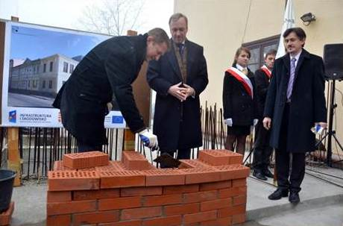
Bronisław Rutkowski Primary and Secondary Music School in Cracow
2008 – the Secondary School of Music
The Music School of the 2nd level (a secondary music school) was established in 2008
.
The launch of the 2nd Level Music School implicated a need of the school building enlargement.
In 2012 funds obtained from an European Community Operational Programme enabled the building expansion works.

Slide 10
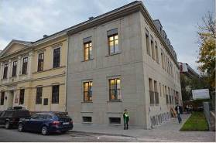
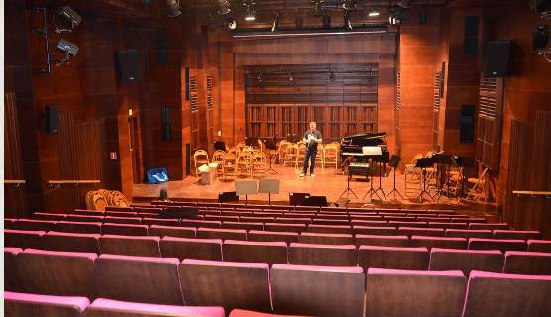
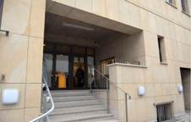
Bronisław Rutkowski Primary and Secondary Music School in Cracow
2014 – the New Building
The new, 4 floor high section of the school building, finished in 2014, added 21 class rooms, as well as a new concert hall able to seat 137 persons.
The building has been made friendly to disabled persons

Slide 11
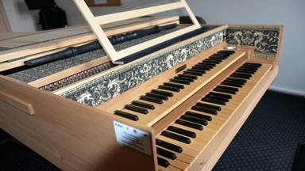
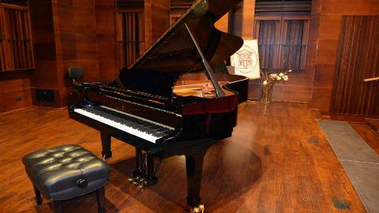
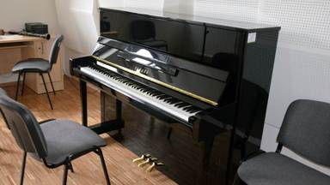
Bronisław Rutkowski Primary and Secondary Music School in Cracow
2014 – New Instruments
In the recent years, thanks to the European funds, the school has bought
a number of new musical instruments, including the historical ones.

Slide 12
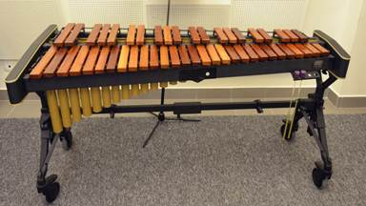
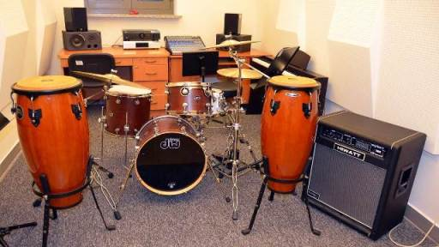
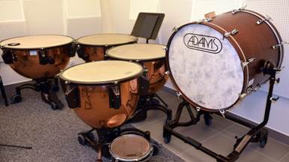
Bronisław Rutkowski Primary and Secondary Music School in Cracow
2014 – New Instruments

Slide 13
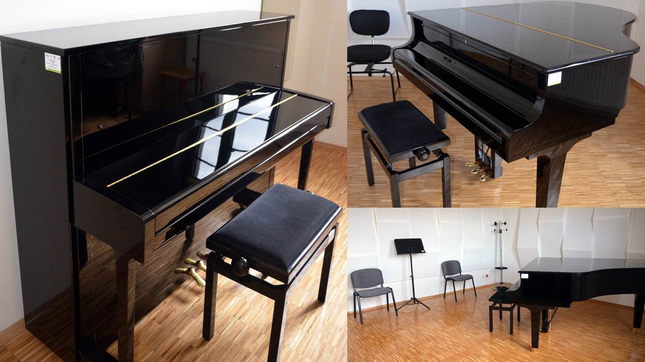
Bronisław Rutkowski Primary and Secondary Music School in Cracow
2014 – New Instruments

Slide 14
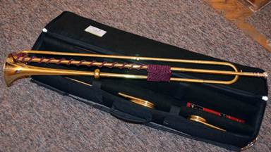
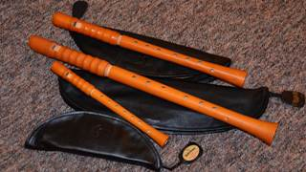
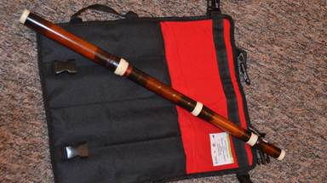
Bronisław Rutkowski Primary and Secondary Music School in Cracow
2014 – New Instruments
The school has acquired a number of replica instruments for the performance of early music

Slide 15
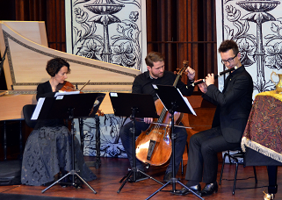
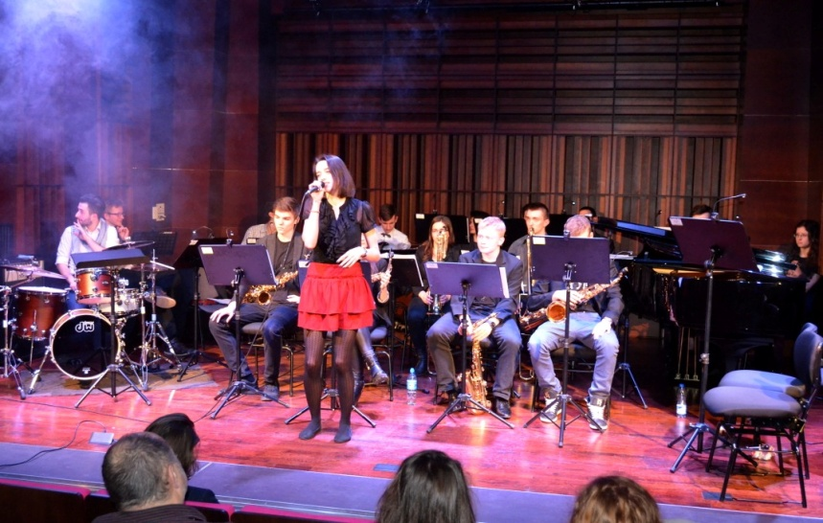
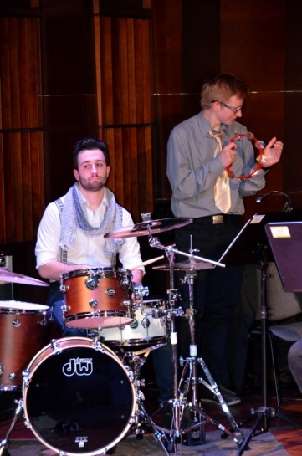
Bronisław Rutkowski Primary and Secondary Music School in Cracow
2014 – New Teaching Specializations
The secondary school of music offers
new specializations:
- at the Instrumental Department:
Early music
Jazz and pop music
- at the Vocal Department:
Jazz and pop music

Slide 16
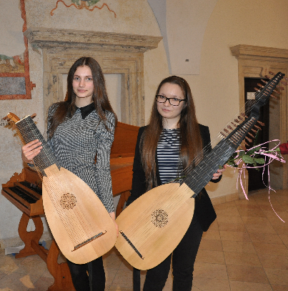
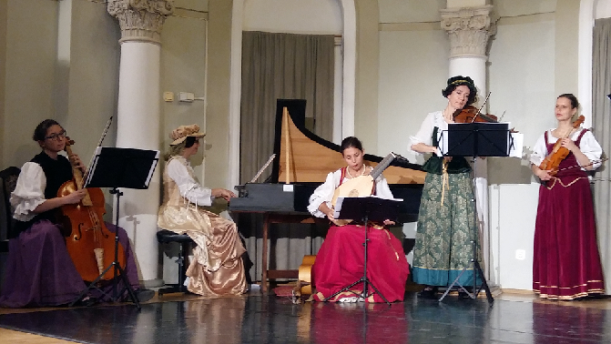
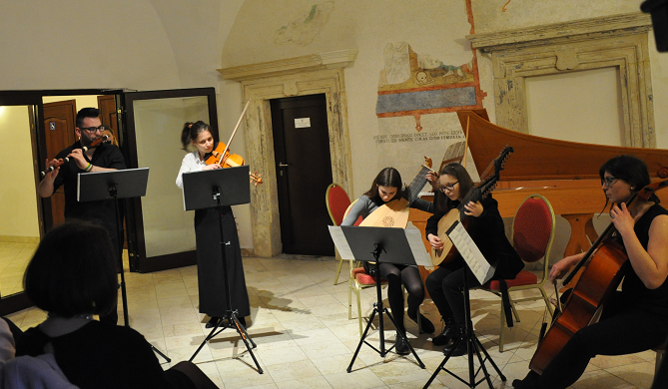
Bronisław Rutkowski Primary and Secondary Music School in Cracow
Early music teaching
teaching possible thanks to new instruments
optional courses

Slide 17
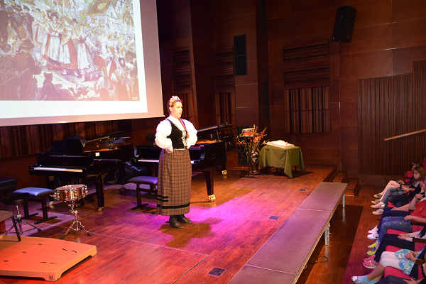
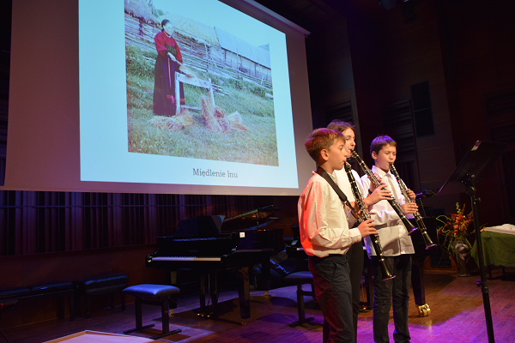
Bronisław Rutkowski Primary and Secondary Music School in Cracow
Activities with folk music
Pieces of folk origin taught during lessons of various instruments
Series of concerts dedicated to national music

Slide 18
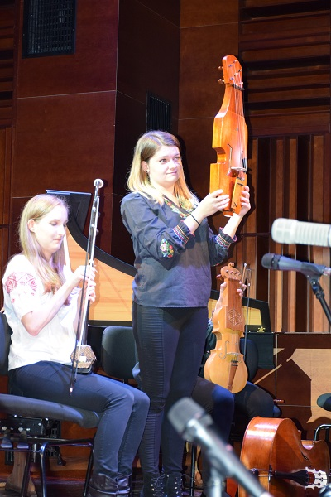
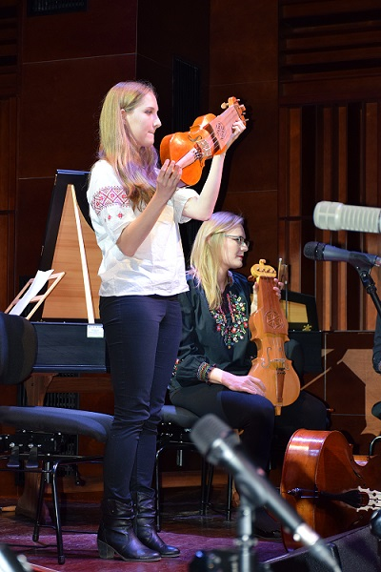
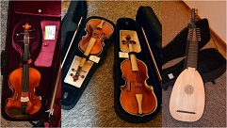
Bronisław Rutkowski Primary and Secondary Music School in Cracow
Ethnic music classes – since 2017
thanks to new instruments bought in 2017
optional courses
1 lesson a week including both playing folk instruments and some theory
only one teacher in the school
Now 4 students altogether who learn to play:
suka biłgorajska
fidel płocka
gadulka

Slide 19

Bronisław Rutkowski Primary and Secondary Music School in Cracow
Concerts promoting the EC projects
Promotion of new instruments

Slide 20
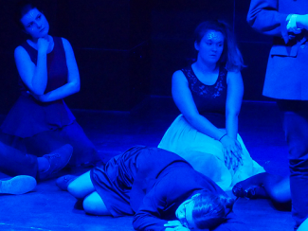
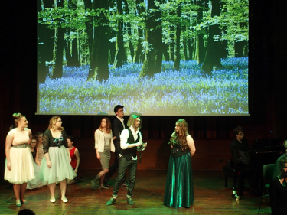
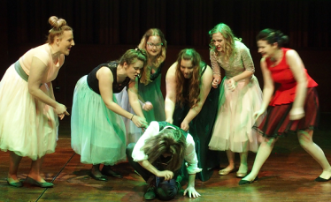
Bronisław Rutkowski Primary and Secondary Music School in Cracow
Stage and dance activity of vocalists
Classes on stage choreography with professional actores
some students frequent ethnic music classes
classes on eurhytmics including basics of dances
1 student is specialising in folk singing (additional classes out of the school)

Slide 21
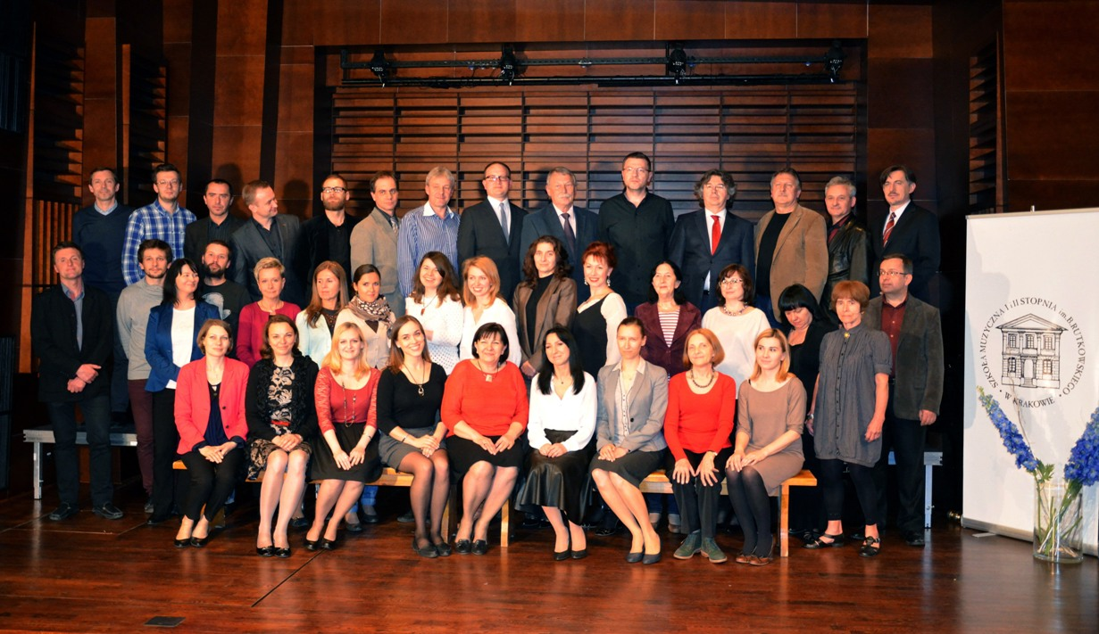
Bronisław Rutkowski Primary and Secondary Music School in Cracow
The Staff
The still increasing staff is composed of well qualified teachers. Most of them are university pedagogues at the same time.

Slide 22

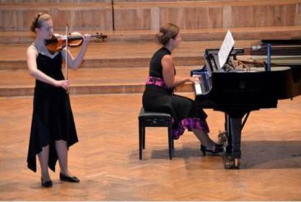
Bronisław Rutkowski Primary and Secondary Music School in Cracow
Regular Events
The school is the organiser of a number of widely famous musical events, such as:
The International Competition of Contemporary Music for Children and Youths „SREBRNA SZYBKA”
Cracow Competition of Young Talents
promoting the achievements of the students
playing string instruments
The All-Poland Irena Kuźma
Piano Competition „Pianogranie”

Slide 23
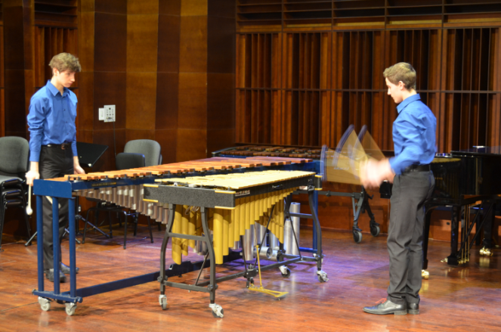
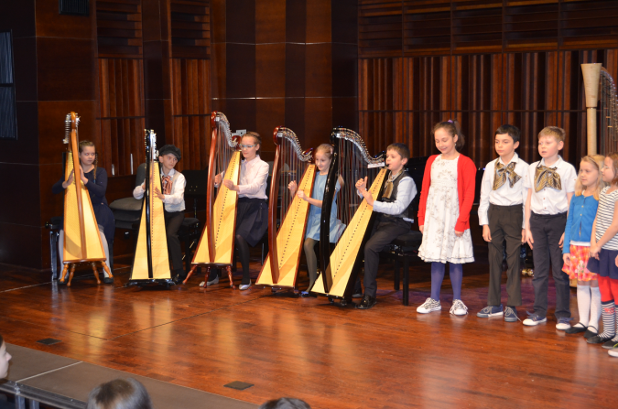
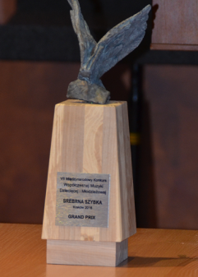
Bronisław Rutkowski Primary and Secondary Music School in Cracow
The International Competition of Contemporary Music
for Children and Youths ‘SREBRNA SZYBKA’ (‘The SILVER GLASS’)
The main idea of the festival is to promote contemporary trends and techniques in composition and performance among learners and teachers of music schools.
It is held biannualy and involves two subcompetitions - performance and composition, to complement the concert calendar in alternate years
The competitions are accompanied
with educational events

Slide 24
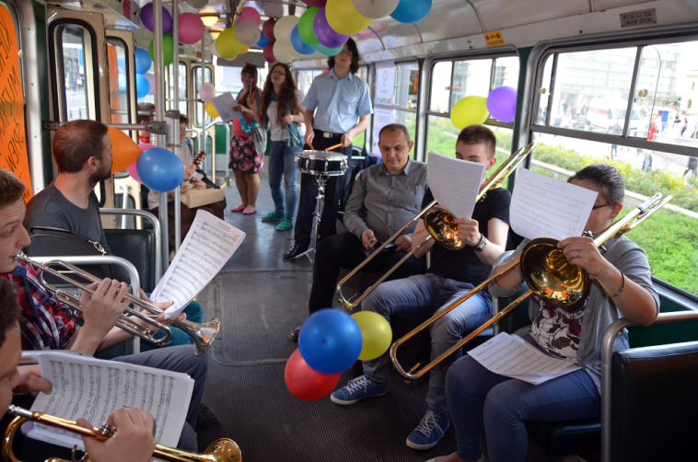
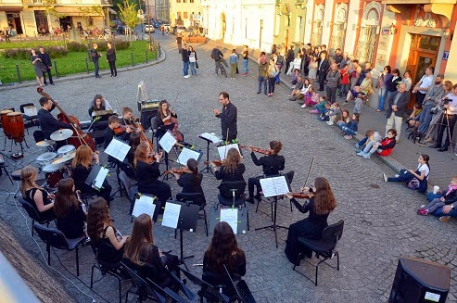
Bronisław Rutkowski Primary and Secondary Music School in Cracow
Local Activity and International Cooperation
Our school is one of the most important cultural institutions in the Podgórze quarter of the city.
The students often take part in occasional events, concerts and ceremonies. The school constantly cooperates with the Music Academy
in Cracow.
Also, it is constantly committed to international cooperation with various centres abroad.

Slide 25
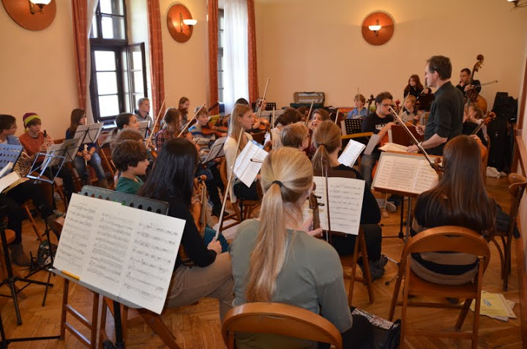
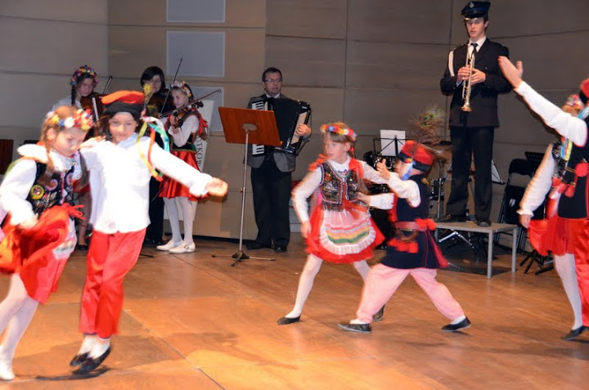
Bronisław Rutkowski Primary and Secondary Music School in Cracow
International Cooperation – Students Exchange with Germany
October 2012 – a visit of students from a music school in Bamberg, Germany
Joint concerts and orchestral workshops
Learning about the Polish culture

Slide 26
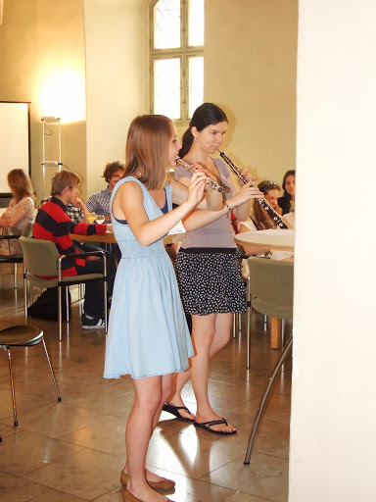
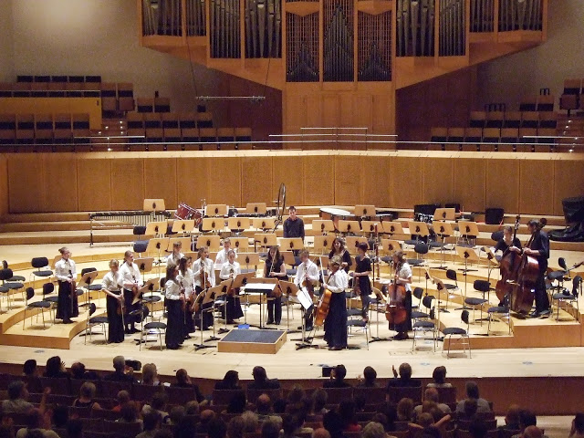
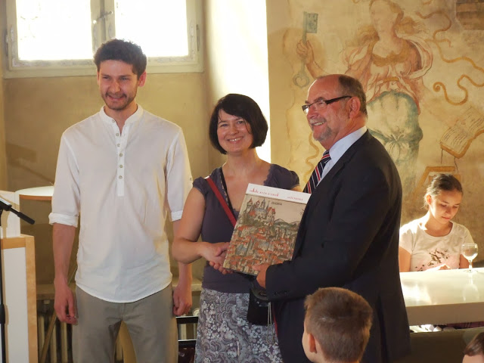
Bronisław Rutkowski Primary and Secondary Music School in Cracow
International Cooperation – Students Exchange with Germany
June 2013 – Our students’ visit in Bamberg, Germany
Joint chamber and orchestral concerts
Workshop with Bamberg philharmonic musicians
Visiting interesting places in Germany

Slide 27
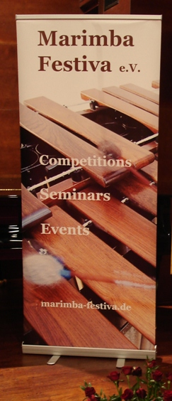

Bronisław Rutkowski Primary and Secondary Music School in Cracow
International Cooperation – the Days of Marimba
October 2014 – International Marimba Days
in the Rutkowski School of Music in cooperation with a music school in Bamberg, Germany

Slide 28



Bronisław Rutkowski Primary and Secondary Music School in Cracow
International Cooperation – Harp Festival
March 2015 – International harp workshop and exhibition organised in the Rutkowski School of Music in cooperation with the CAMAC HARP company in France
Guests from France, Swizerland, Lithuania, Australia

Slide 29


Bronisław Rutkowski Primary and Secondary Music School in Cracow
International Cooperation – a visit in China
June 2015 – our school was invited to take part in the international
Educational Cooperation Conference in Ningbo - China
The Letter of Intention for Twin School Bonding between the Ningbo Foreign Affairs School and the Bronisław Rutkowski School of Music was signed

Slide 30



Bronisław Rutkowski Primary and Secondary Music School in Cracow
International Cooperation – Students Exchange with Hungary
April 2016 – a visit of students from Budapest
Concert of the orchestra from Budapest in our school
Students meetings

Slide 31



Bronisław Rutkowski Primary and Secondary Music School in Cracow
International Cooperation – Students Exchange with Hungary
June 2016 – Our students’ visit in Budapest, Hungary
Common workshops
Joint orchestral concerts
Visiting Budapest

Slide 32


Bronisław Rutkowski Primary and Secondary Music School in Cracow
International Cooperation – Erasmus+, an ongoing project
In August 2017 – Our school won a grant from the Erasmus+ EU programme for the following project (November 2017 – November 2019):
Our partners:
"Professor Pancho Vladigerov" National school for Musical and Performing arts in Burgas, Bulgaria
György Kroó Music and Fine Arts School in Budapest, Hungary
sound engineers from the Technical College at the Special School-Education Center for Blind Students in Kraków, Poland

Slide 33
Bronisław Rutkowski Primary and Secondary Music School in Cracow
International Cooperation – Erasmus+, an ongoing project
Blended mobility of learners. Three meetings planned:
Budapest – 2018 Burgas – 2018 Kraków – 2019:
During the meetings:
Learning national music and dances of partner countries
Chamber, orchestral and choir workshops with teachers of the partner schools
Observation of lessons in partner institutions
Preparation of joint concerts for wide audience

Slide 34

Bronisław Rutkowski Primary and Secondary Music School in Cracow

Slide 35

Bronisław Rutkowski Primary and Secondary Music School in Cracow
More and More Students
In the recent years the number of the candidates taking the entrance examination to both schools, that is primary and secondary ones, exceeded the capacity three times every year

Slide 36
Bronisław Rutkowski Primary and Secondary Music School in Cracow
CONTACT
Szkoła Muzyczna I i II stopnia im. Bronisława Rutkowskiego
ul. Józefińska 10 , 30-529 Kraków, Poland
phone / fax: +48 12 656 09 45
www.sm1krakow.pl/ e-mail: dyrekcja@sm1krakow.pl

